Slide 1
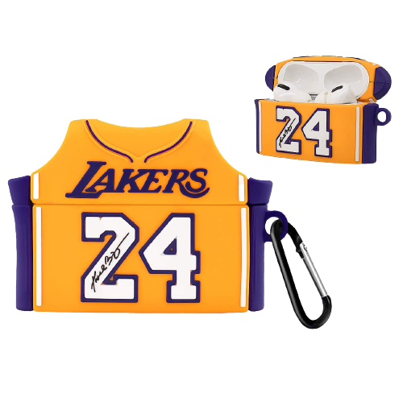
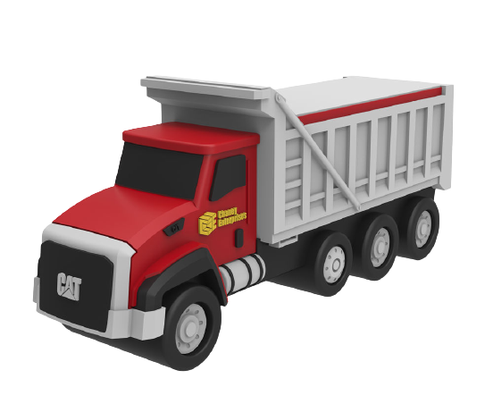
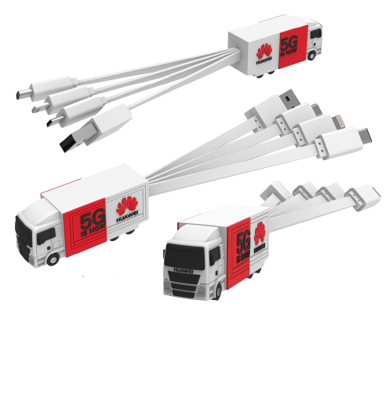
100% Customized
PVC Gift Items
A PERFECT COMBINATION OF CREATIVITY AND UNIQUENESS

Slide 2
Company Introduction
Gift-Supplier was founded in 2008 located in Mainland China. We specialize in customizing of branded corporate gifts for organizations worldwide. The customizable products that we offer are either coming from our own factories or partner companies across the China.
We mostly work with big companies from various industries worldwide. For every transaction, we work with the focus to deliver the right products fast. We listen to our clients' demands, after which, we either develop or suggest options that may suit their budget, event theme, brand image, and target goals.
We are a trusted partner with >13 years' experience in gift customization and delivery:
105 million corporate gifts delivered since 2008
4000+ unique products available with new items added monthly
Customers from Fortune 500® to small family businesses and from small churches and schools to major universities and hospitals
Core Value:
At Gift-Supplier we truly value our relationships with our customers, and know that these relationships are based on trust in us to provide the highest quality products with the highest level of service. We always strive to adhere to the highest standards of honesty and integrity in every customer interaction.
www.gift-supplier.com

Slide 3
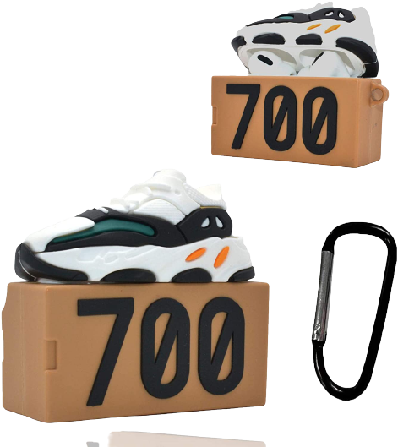
Why Custom
Gift Items are so popular ?
-Custom items are in demand since it has its distinct unique value. You can turn your idea into a real product by creating custom items.
-This can WOW your audience and create a distinctive difference unique value from your competitors.
www.gift-supplier.com

Slide 4
What are PVC material characteristics and advantages?
Versatile-Can be any shapes
100%
Cost-effective
100%
Chemical Resistance
100%
Abrasion Resistant
100%
Eco-Friendly
100%
ABOUT
PVC Material
www.gift-supplier.com

Slide 5
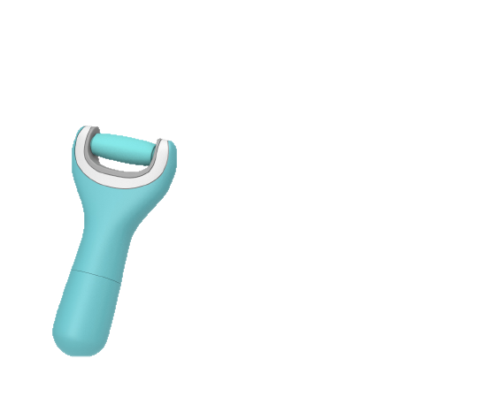
Process to make a 100% customized gift item
01
Start with simple photos
02
Convert the image into a rendering
03
Create a computer-generated mockup
04
Produce a hand molded sample as a visual or physical proof
05
Deliver the Custom items
www.gift-supplier.com

Slide 6
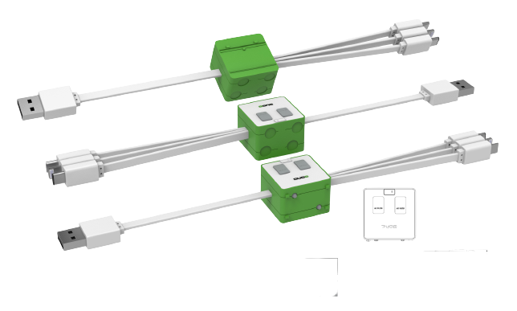
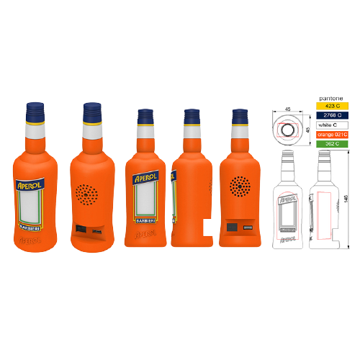
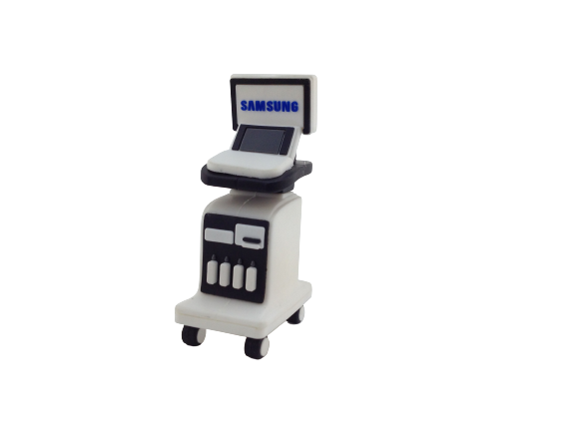
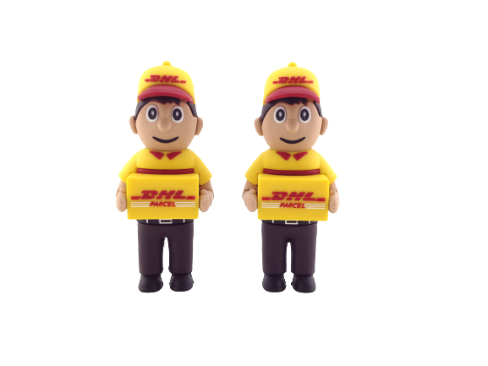
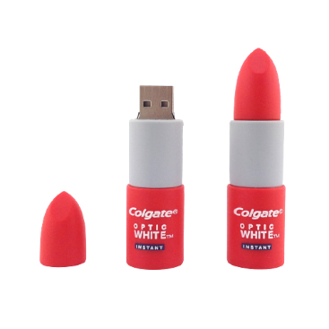
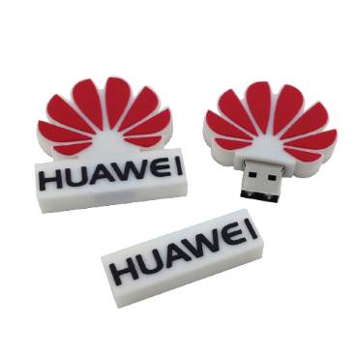
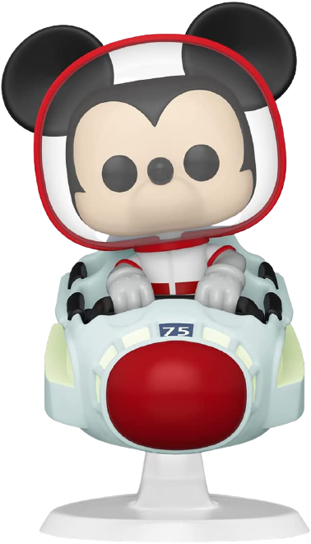
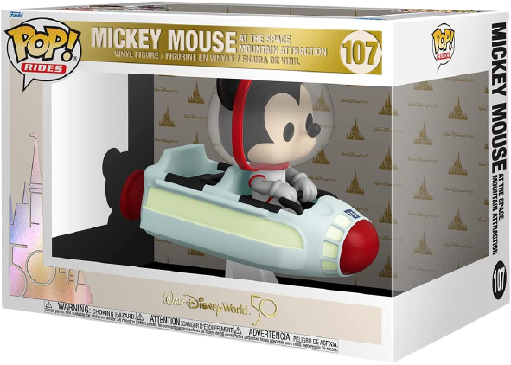
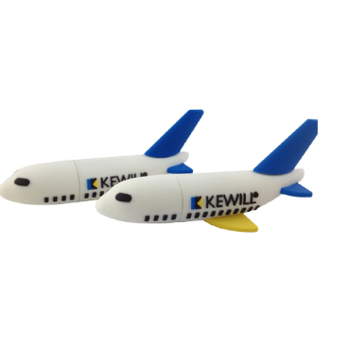
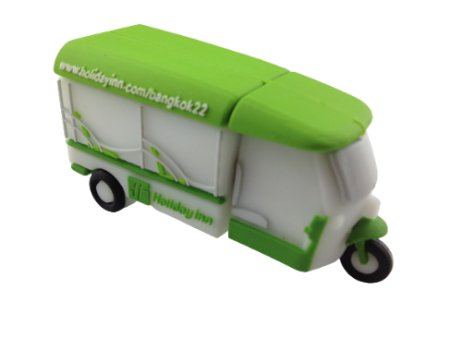
Successful Case
www.gift-supplier.com

Slide 7
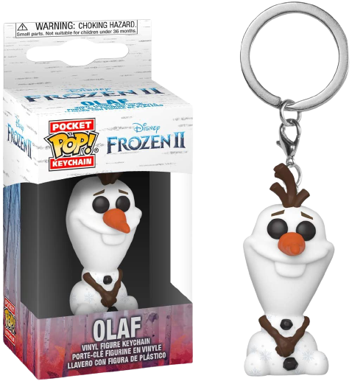
What Items We Can Provide
Custom Vinyl Figure
Custom Keychain
PVC Patch
Airpod Pro Protective Case
www.gift-supplier.com

Slide 8
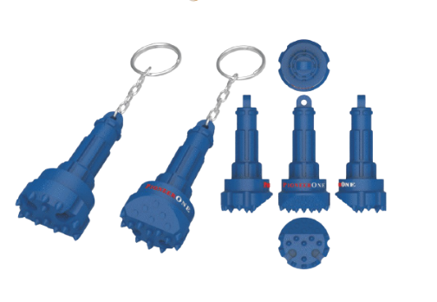
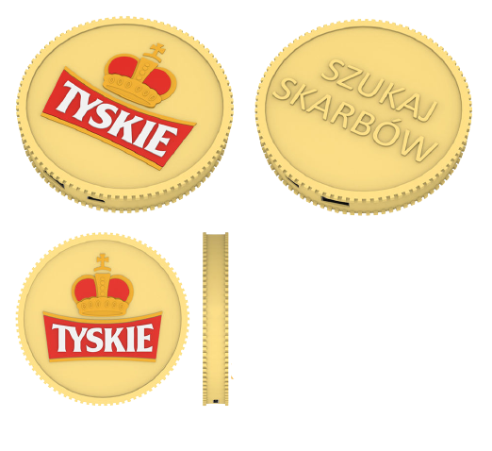
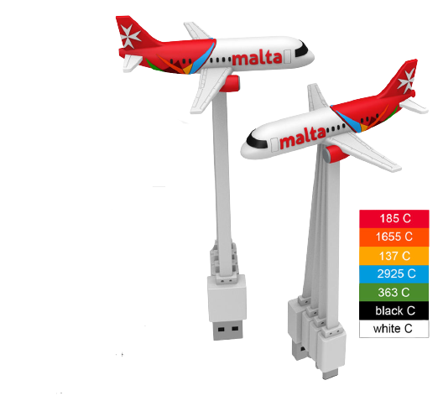
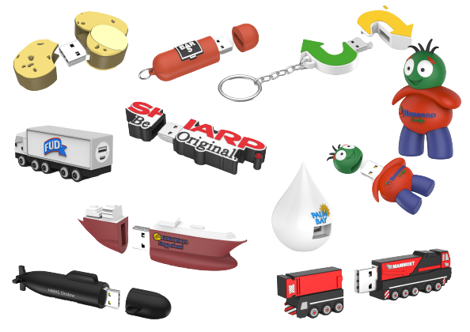
What Items We Can Provide
Custom Keychain
Custom Wireless Charger
USB Flash Drive
Custom Cable
www.gift-supplier.com

Slide 9
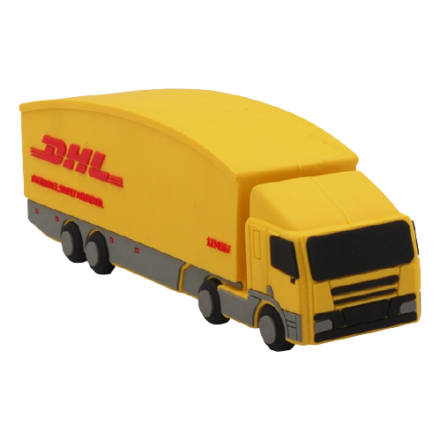
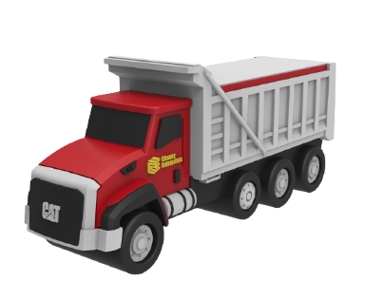
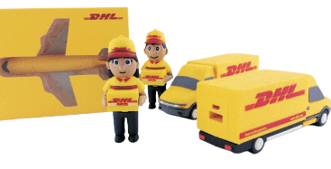
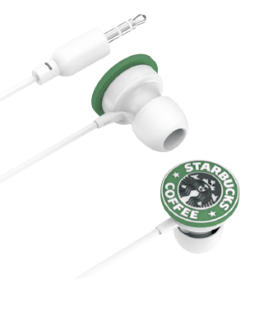
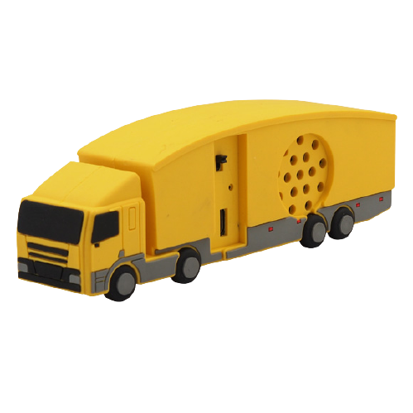
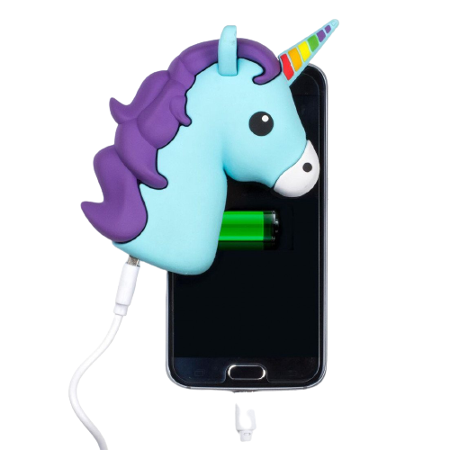
There are more…
Custom Speaker
Custom Gift Set
Custom Power Bank
Custom earbuds
www.gift-supplier.com

Slide 10
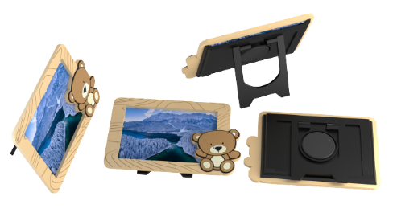
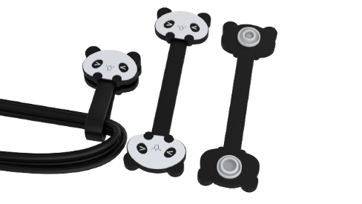
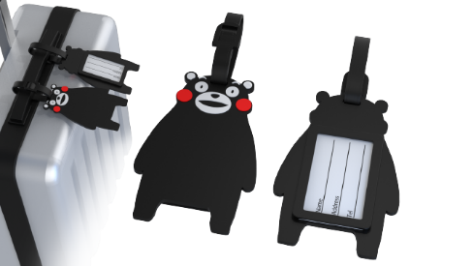
100% Custom Artistic PVC Gift Items
Photo Frame
Cable Organizer
Luggage Tag
Zipper Pull
www.gift-supplier.com

Slide 11
There Are More PVC Customized Gift Items
We Can Make!
Please feel free to make contact at:
Sales@gift-supplier.com
Our Pleasure to Help You!

